Slide 1
Applied Cryptography Dixon’s random squares algorithm, semantic security, discrete logarithm
Liangfeng Zhang
School of Information Science and Technology
ShanghaiTech University

Slide 2
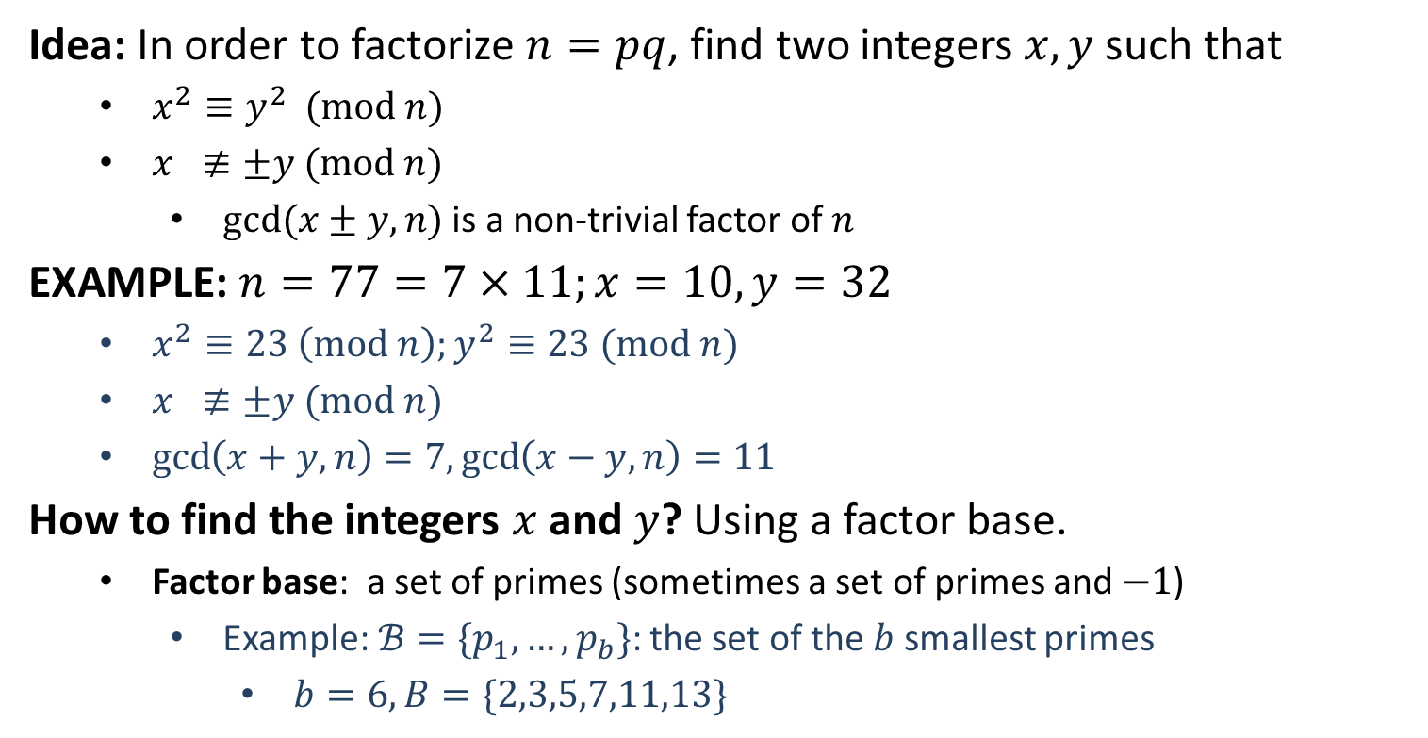
Dixon’s Random Squares Algorithm
Idea: In order to factorize $n=pq$, find two integers $x,y$ such that
$x^{2}≡y^{2} (mod n)$
$x ≢±y (mod n)$
$gcd⁡(x±y,n)$ is a non-trivial factor of $n$
EXAMPLE: $n=77=7×11;x=10, y=32$
$x^{2}≡23 \left(mod n\right);y^{2}≡23 (mod n)$
$x ≢±y (mod n)$
$\gcd\left(x+y,n\right)=7,\gcd\left(x−y,n\right)=11$
How to find the integers $x$ and $y$? Using a factor base.
Factor base: a set of primes (sometimes a set of primes and $−1$)
Example:$ℬ=\{p_{1},…,p_{b}\}$: the set of the $b$ smallest primes
$b=6, B=\{2,3,5,7,11,13\}$

Slide 3
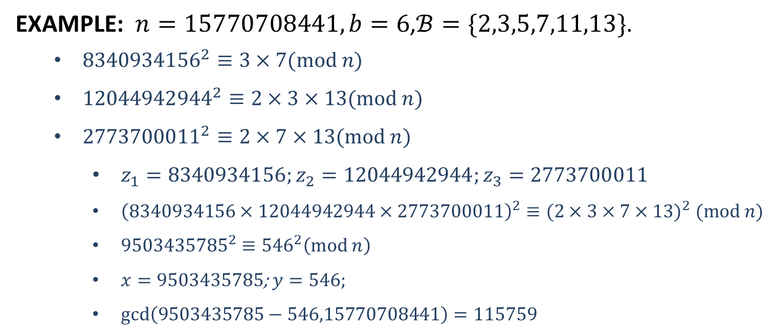
Dixon’s Random Squares Algorithm
EXAMPLE: $n=15770708441, b=6$,$ℬ=\{2,3,5,7,11,13\}$.
${8340934156}^{2}≡3×7(mod n)$
${12044942944}^{2}≡2×3×13(mod n)$
${2773700011}^{2}≡2×7×13(mod n)$
$z_{1}=8340934156;z_{2}=12044942944;z_{3}=2773700011$
${\left(8340934156×12044942944×2773700011\right)}^{2}≡(2×3×7×{13)}^{2} (mod n)$
${9503435785}^{2}≡{546}^{2}\left(mod n\right)$
$x=9503435785$; $y=546;$
$gcd\left(9503435785−546,15770708441\right)=115759$

Slide 4
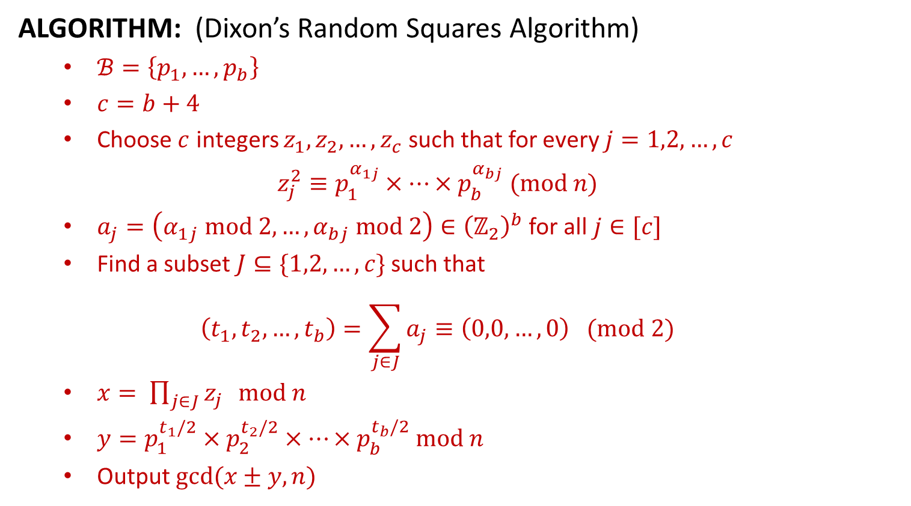
Dixon’s Random Squares Algorithm
ALGORITHM: (Dixon’s Random Squares Algorithm)
$ℬ=\left\{p_{1},…,p_{b}\right\}$
$c=b+4$
Choose $c$ integers $z_{1},z_{2},…,z_{c}$ such that for every $j=1,2,…,c$
$$z_{j}^{2}≡p_{1}^{α_{1j}}×…×p_{b}^{α_{bj}} (mod n)$$
$a_{j}=\left(α_{1j} mod 2,…,α_{bj} mod 2\right)∈{\left(ℤ_{2}\right)}^{b}$ for all $j∈[c]$
Find a subset $J⊆\{1,2,…,c\}$ such that
$$\left(t_{1},t_{2},…,t_{b}\right)=\sum_{j∈J}{a_{j}}≡\left(0,0,…,0\right) (mod 2)$$
$x= \prod_{j∈J}{z_{j}} mod n$
$y=p_{1}^{t_{1}/2}×p_{2}^{t_{2}/2}×⋯×p_{b}^{t_{b}/2}$ $mod n$
Output $gcd⁡(x±y,n)$

Slide 5
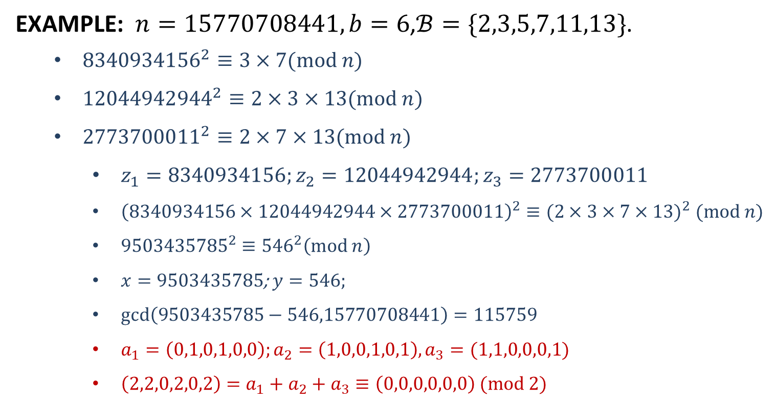
Dixon’s Random Squares Algorithm
EXAMPLE: $n=15770708441, b=6$,$ℬ=\{2,3,5,7,11,13\}$.
${8340934156}^{2}≡3×7(mod n)$
${12044942944}^{2}≡2×3×13(mod n)$
${2773700011}^{2}≡2×7×13(mod n)$
$z_{1}=8340934156;z_{2}=12044942944;z_{3}=2773700011$
${\left(8340934156×12044942944×2773700011\right)}^{2}≡(2×3×7×{13)}^{2} (mod n)$
${9503435785}^{2}≡{546}^{2}\left(mod n\right)$
$x=9503435785$; $y=546;$
$gcd\left(9503435785−546,15770708441\right)=115759$
$a_{1}=\left(0,1,0,1,0,0\right);a_{2}=\left(1,0,0,1,0,1\right), a_{3}=(1,1,0,0,0,1)$
$\left(2,2,0,2,0,2\right)=a_{1}+a_{2}+a_{3}≡\left(0,0,0,0,0,0\right) (mod 2)$

Slide 6

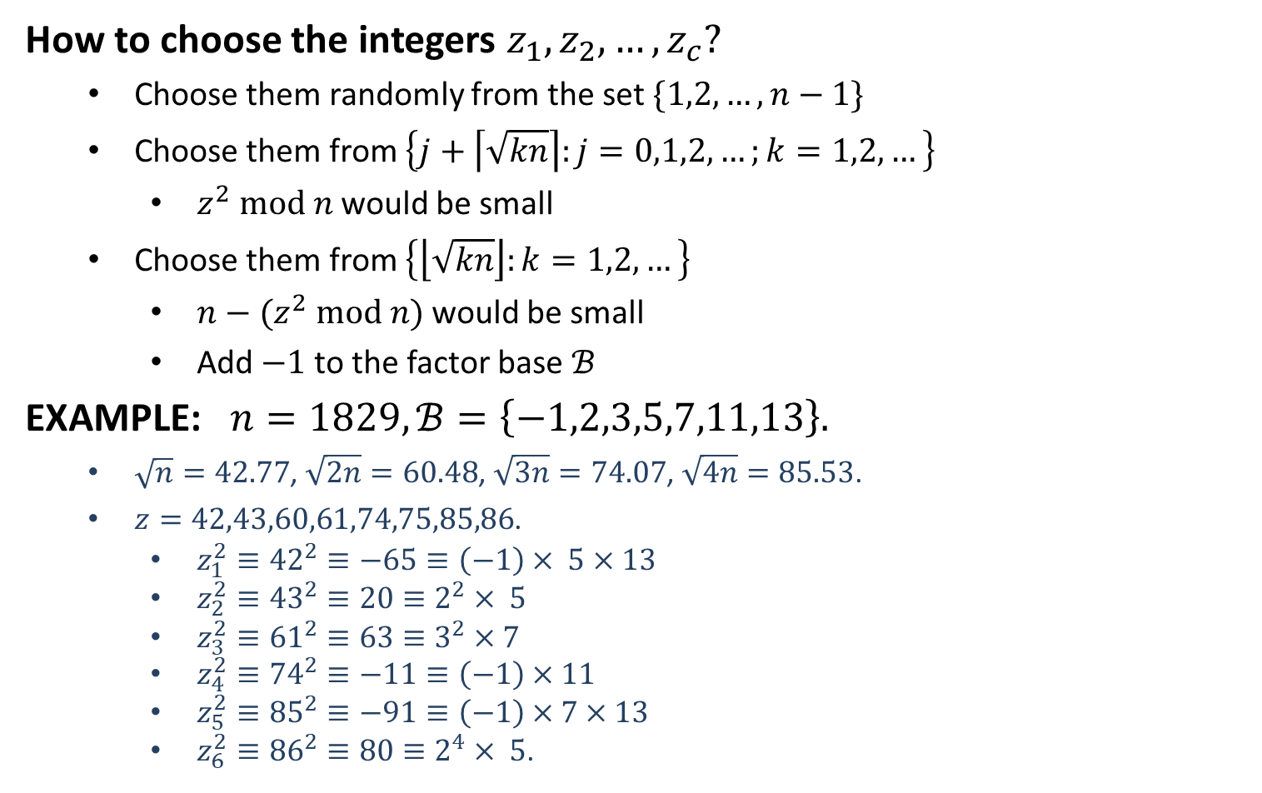
Dixon’s Random Squares Algorithm
How to choose the integers $z_{1},z_{2},…,z_{c}?$
Choose them randomly from the set $\{1,2,…,n−1\}$
Choose them from $\left\{j+\left\lceil \sqrt{kn}\right\rceil :j=0,1,2,…;k=1,2,…\right\}$
$z^{2} mod n$ would be small
Choose them from $\left\{\left\lfloor \sqrt{kn}\right\rfloor :k=1,2,…\right\}$
$n−(z^{2} mod n)$ would be small
Add $−1$ to the factor base $ℬ$
EXAMPLE: $n=1829, ℬ=\left\{−1,2,3,5,7,11,13\right\}.$
$\sqrt{n}=42.77$, $\sqrt{2n}=60.48$, $\sqrt{3n}=74.07$, $\sqrt{4n}=85.53$.
$z=42,43,60,61,74,75,85,86$.
$z_{1}^{2}≡{42}^{2}≡−65≡\left(−1\right)× 5×13$
$z_{2}^{2}≡{43}^{2}≡20≡2^{2}× 5$
$z_{3}^{2}≡{61}^{2}≡63≡3^{2}×7$
$z_{4}^{2}≡{74}^{2}≡−11≡\left(−1\right)×11$
$z_{5}^{2}≡{85}^{2}≡−91≡\left(−1\right)×7×13$
$z_{6}^{2}≡{86}^{2}≡80≡2^{4}× 5$.
$a_{1}=\left(1,0,0,1,0,0,1\right)$
$a_{2}=\left(0,0,0,1,0,0,0\right)$
$a_{3}=\left(0,0,0,0,1,0,0\right)$
$a_{4}=\left(1,0,0,0,0,1,0\right)$
$a_{5}=\left(1,0,0,0,1,0,1\right)$
$a_{6}=\left(0,0,0,1,0,0,0\right)$

Slide 7
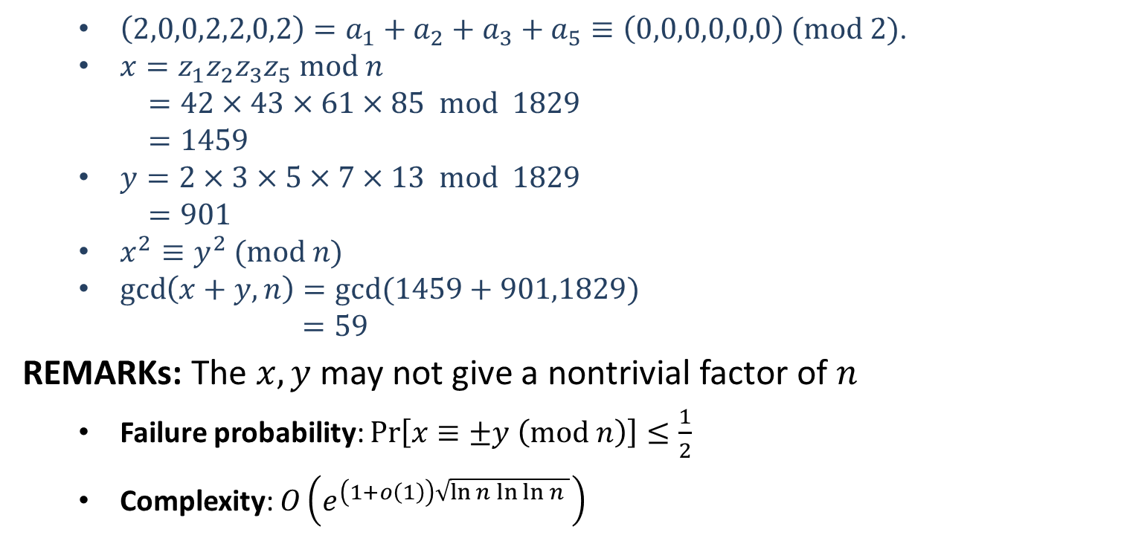
Dixon’s Random Squares Algorithm
$\left(2,0,0,2,2,0,2\right)=a_{1}+a_{2}+a_{3}+a_{5}≡\left(0,0,0,0,0,0\right) (mod 2)$.
$x=z_{1}z_{2}z_{3}z_{5} mod n$
$=42×43×61×85 mod 1829$
$=1459$
$y=2×3×5×7×13 mod 1829$
$=901$
$x^{2}≡y^{2} (mod n)$
$\gcd\left(x+y,n\right)=gcd⁡(1459+901,1829)$
$=59$
REMARKs: The $x,y$ may not give a nontrivial factor of $n$
Failure probability: $\operatorname{Pr}\left[x≡±y \left(mod n\right)\right]≤\frac{1}{2}$
Complexity: $O\left(e^{\left(1+o\left(1\right)\right)\sqrt{\ln{n\ln{\ln{n} }}}}\right)$

Slide 9
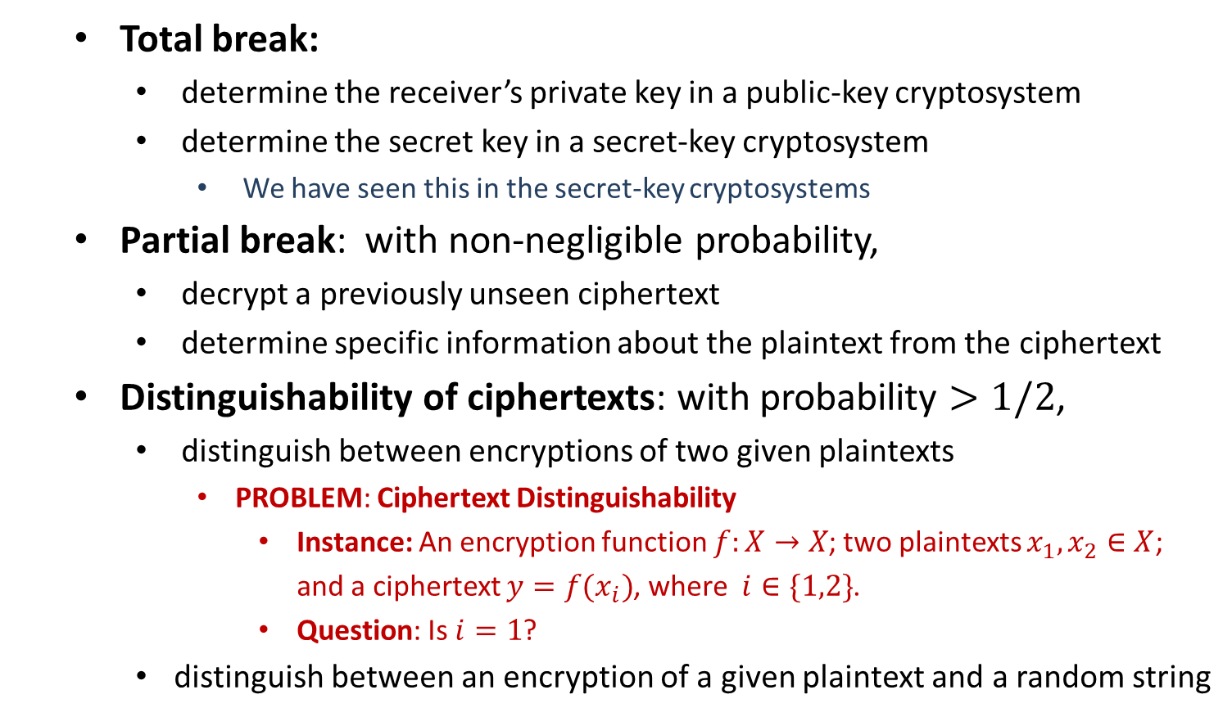
Adversarial Goals in a Cryptosystem
Total break:
determine the receiver’s private key in a public-key cryptosystem
determine the secret key in a secret-key cryptosystem
We have seen this in the secret-key cryptosystems
Partial break: with non-negligible probability,
decrypt a previously unseen ciphertext
determine specific information about the plaintext from the ciphertext
Distinguishability of ciphertexts: with probability $>1/2$,
distinguish between encryptions of two given plaintexts
PROBLEM: Ciphertext Distinguishability
Instance: An encryption function $f:X→X$; two plaintexts $x_{1},x_{2}∈X$; and a ciphertext $y=f(x_{i})$, where $i∈\{1,2\}$.
Question: Is $i=1$?
distinguish between an encryption of a given plaintext and a random string

Slide 10
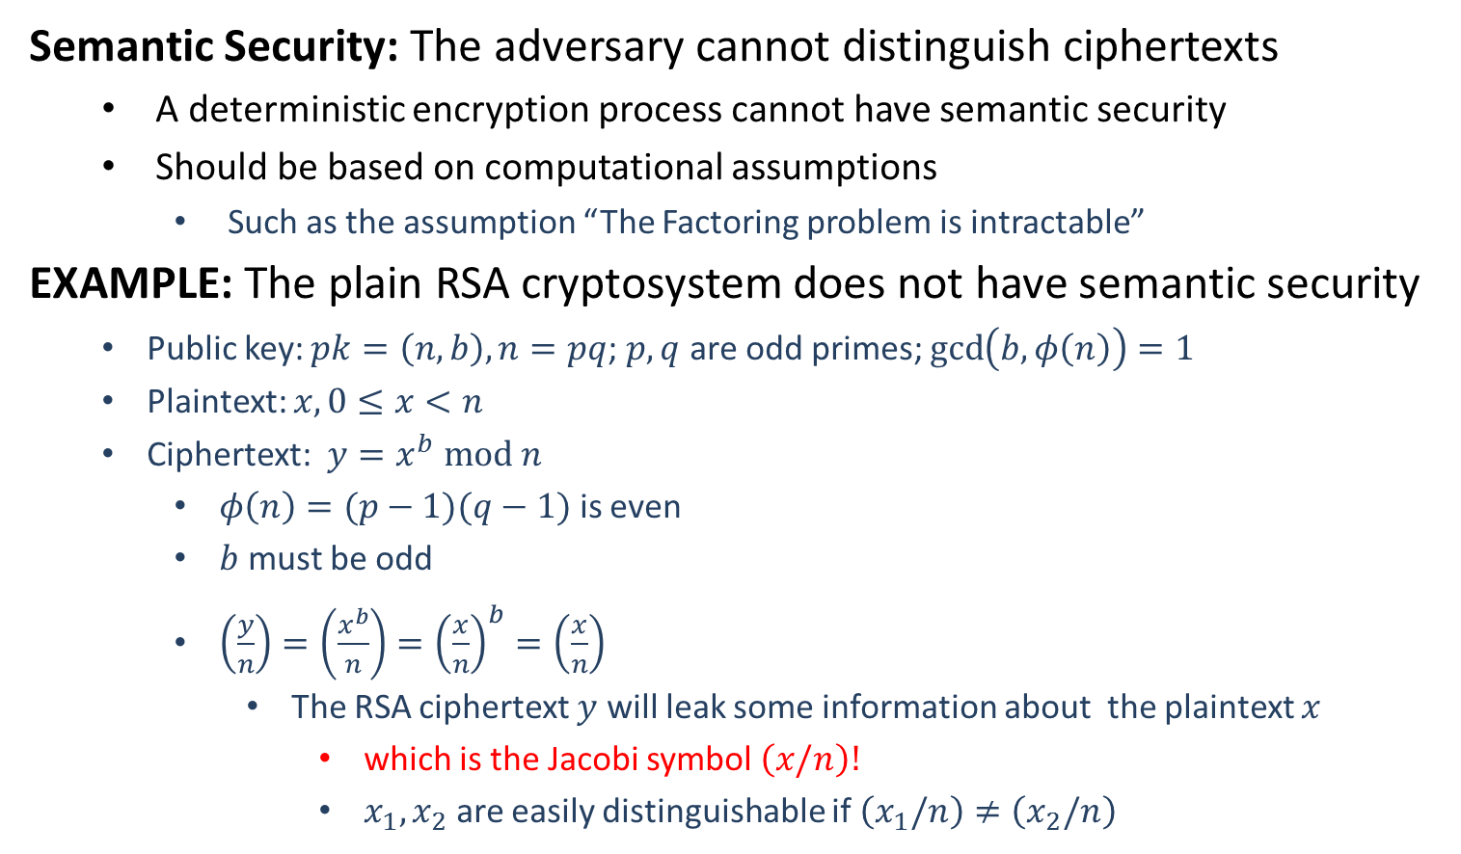
Semantic Security
Semantic Security: The adversary cannot distinguish ciphertexts
A deterministic encryption process cannot have semantic security
Should be based on computational assumptions
Such as the assumption “The Factoring problem is intractable”
EXAMPLE: The plain RSA cryptosystem does not have semantic security
Public key: $pk=\left(n,b\right), n=pq$; $p,q$ are odd primes; $\gcd\left(b,φ\left(n\right)\right)=1$
Plaintext: $x, 0≤x<n$
Ciphertext: $y=x^{b} mod n$
$φ\left(n\right)=(p−1)(q−1)$ is even
$b$ must be odd
$\left(\frac{y}{n}\right)=\left(\frac{x^{b}}{n}\right)={\left(\frac{x}{n}\right)}^{b}=\left(\frac{x}{n}\right)$
The RSA ciphertext $y$ will leak some information about the plaintext $x$
which is the Jacobi symbol $\left(x/n\right)!$
$x_{1},x_{2}$ are easily distinguishable if $\left(x_{1}/n\right)≠\left(x_{2}/n\right)$

Slide 11
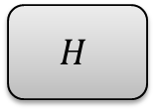

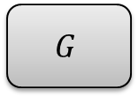

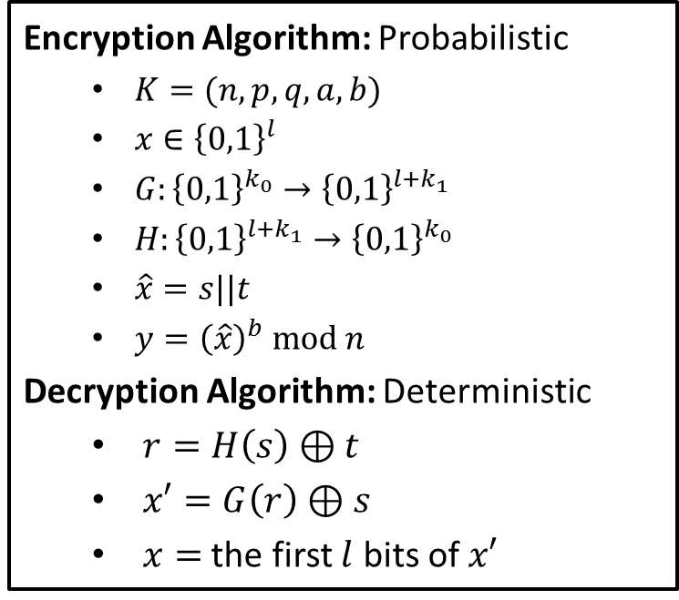




RSA-OAEP
RSA Optimal Asymmetric Encryption Padding: RSA PKCS #1 (since v2.0)
$$x||0^{k_{1}}$$
$$r$$
Encryption Algorithm: Probabilistic
$K=(n,p,q,a,b)$
$x∈{\left\{0,1\right\}}^{l}$
$G:{\left\{0,1\right\}}^{k_{0}}→{\left\{0,1\right\}}^{l+k_{1}}$
$H:{\left\{0,1\right\}}^{l+k_{1}}→{\left\{0,1\right\}}^{k_{0}}$
$\hat{x}=s||t$
$y={\left(\hat{x}\right)}^{b} mod n$
Decryption Algorithm: Deterministic
$r=H\left(s\right)⊕t$
$x′=G\left(r\right)⊕s$
$x=$ the first $l$ bits of $x′$
$$G$$
$$H$$
$$s$$
$$t$$
$l+k_{1}$ bits
$k_{0}$ bits
RSA-OAEP is semantically secure under CCA
“Optimal asymmetric encryption”
Mihir Bellare, Phillip Rogaway, 1994

Slide 13
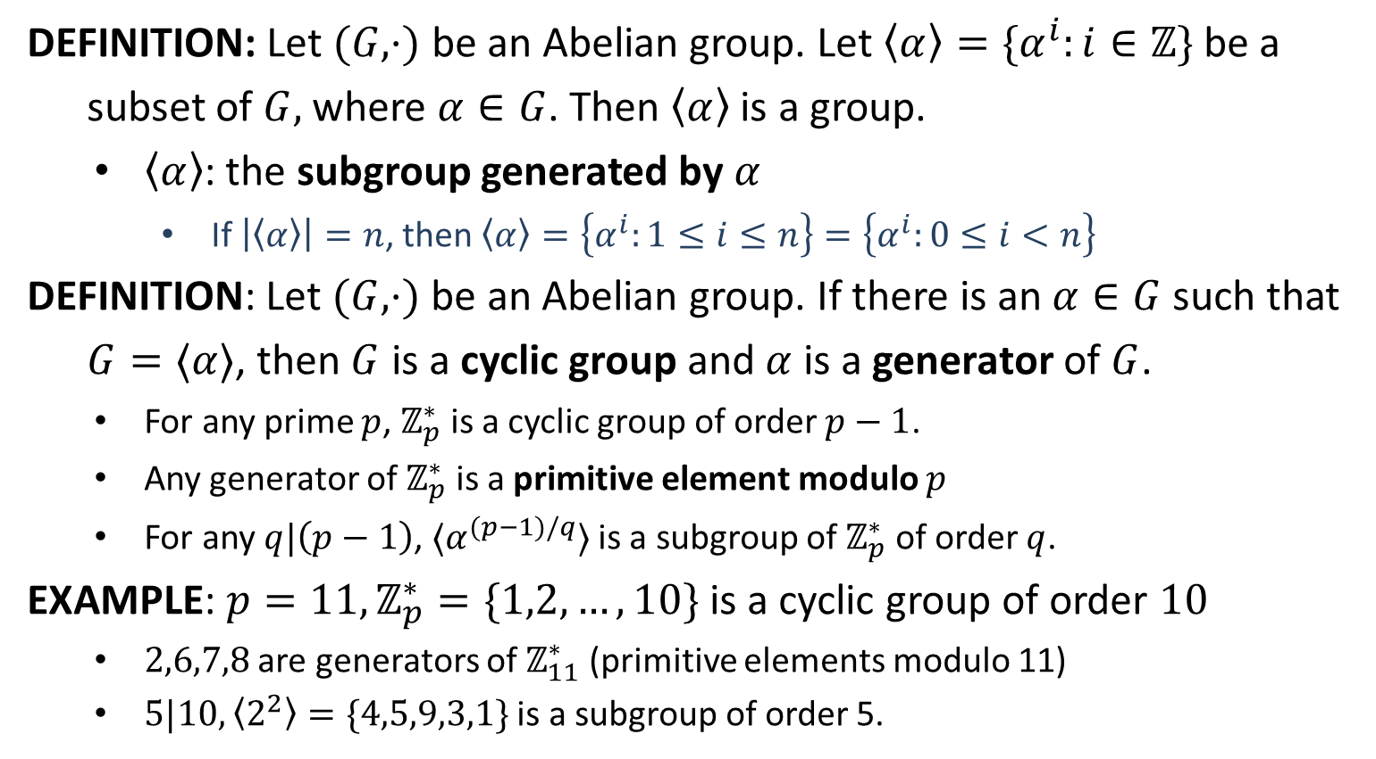
Cyclic Group
DEFINITION: Let $(G,⋅)$ be an Abelian group. Let $〈α〉=\{α^{i}:i∈ℤ\}$ be a
subset of $G,$ where $α∈G$. Then $〈α〉$ is a group.
$〈α〉$: the subgroup generated by $α$
If $\left|〈α〉\right|=n$, then $〈α〉=\left\{α^{i}:1≤i≤n\right\}=\left\{α^{i}:0≤i<n\right\}$
DEFINITION: Let $(G,⋅)$ be an Abelian group. If there is an $α∈G$ such that
$G=〈α〉$, then $G$ is a cyclic group and $α$ is a generator of $G$.
For any prime $p$, $ℤ_{p}^{∗}$ is a cyclic group of order $p−1$.
Any generator of $ℤ_{p}^{∗}$ is a primitive element modulo $p$
For any $q|\left(p−1\right)$, $〈α^{(p−1)/q}〉$ is a subgroup of $ℤ_{p}^{∗}$ of order $q$.
EXAMPLE: $p=11, ℤ_{p}^{∗}=\{1,2,…,10\}$ is a cyclic group of order $10$
$2,6,7,8$ are generators of $ℤ_{11}^{∗}$ (primitive elements modulo 11)
$5|10, 〈2^{2}〉=\{4,5,9,3,1\}$ is a subgroup of order 5.

Slide 14

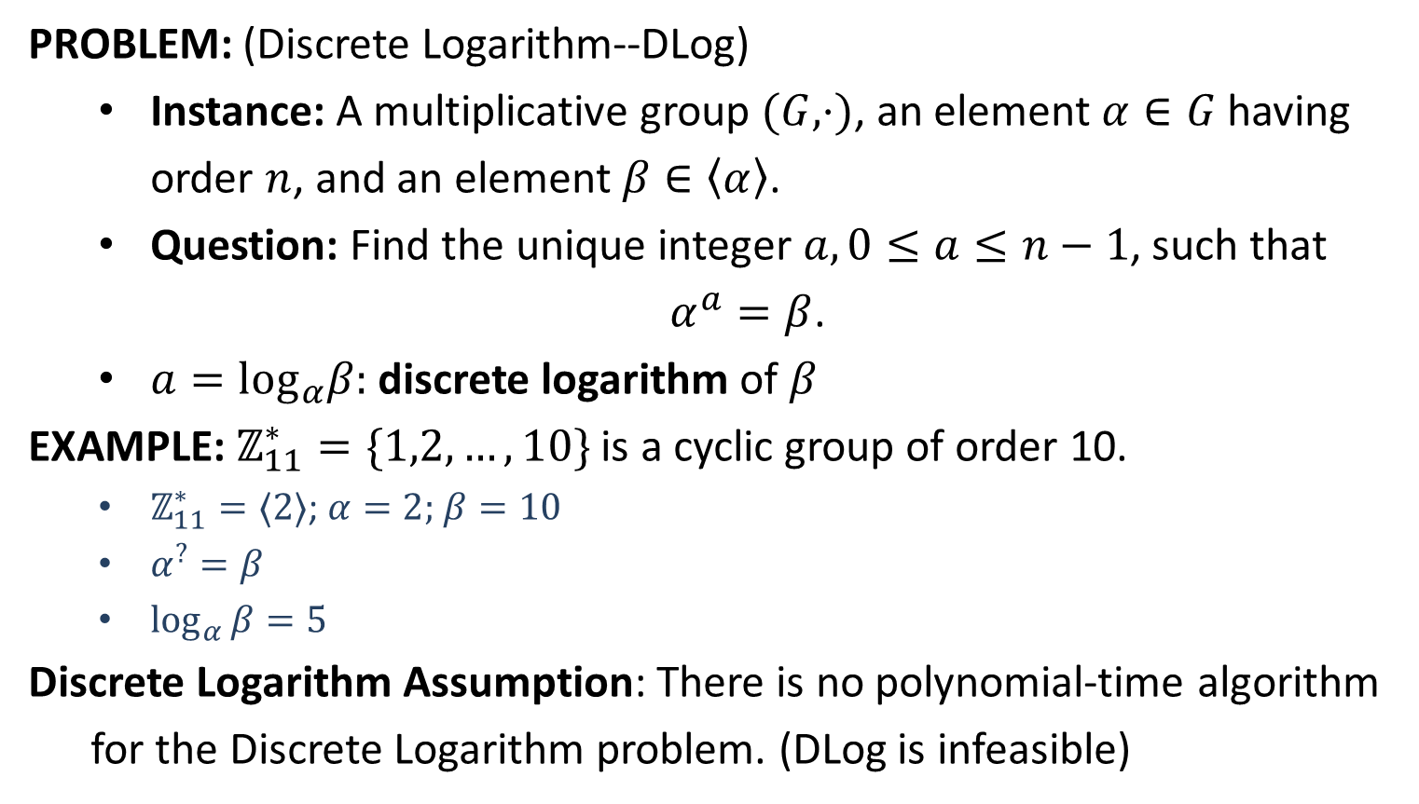
Discrete Logarithm
PROBLEM: (Discrete Logarithm--DLog)
Instance: A multiplicative group $(G, ⋅)$, an element $α∈G$ having order $n$, and an element $β∈\left\langle α\right\rangle$.
Question: Find the unique integer $a,0≤a≤n−1$, such that
$α^{a}=β$.
$a=\log_{α}β:$discrete logarithm of $β$
EXAMPLE: $ℤ_{11}^{∗}=\{1,2,…,10\}$ is a cyclic group of order 10.
$ℤ_{11}^{∗}=〈2〉$; $α=2;$ $β=10$
$α^{?}=β$
$\log_{α}{β=5}$
Discrete Logarithm Assumption: There is no polynomial-time algorithm
for the Discrete Logarithm problem. (DLog is infeasible)
$$α^{5}=β$$

